Slide 1
Malignant- Comments- Classification Project

Slide 2
Exploratory Data Analysis

Slide 3
Steps
Importing the libraries needed for my project
Loading the dataset/Creating my train and test data frame
Checking the shape of the dataset
Checking the datatypes
Checking for null values if any
The data analysis help us to get an overview of our dataset and also helps in pre-processing of the data.

Slide 4
Preprocessing of the data

Slide 5
Steps and Description
I have checked the correlation between the target variables.
I have studied the statistical summary of the train and test dataset.
I have done some visualization using count plots.
Then I have converted the comments in train data into lowercase.
Then I have removed punctuations , stop words to get a clean length.
Then I have converted text into vectors using TF-IDF so that the data gets ready for model building.
I splitted the dataset(independent and dependant) variables into x and y.

Slide 6
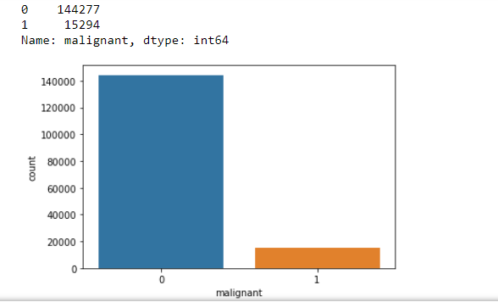
Some more pre-processing steps
Statistical summary of the dataset is studied.
Some visualization is done using count-plots, pie-plot where we can see how our data look like. Below are some of the screenshots:-

Slide 7
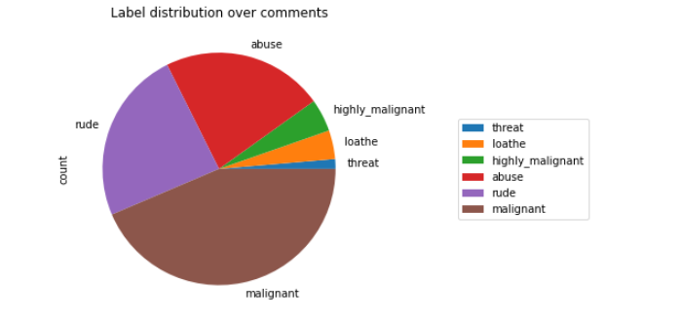
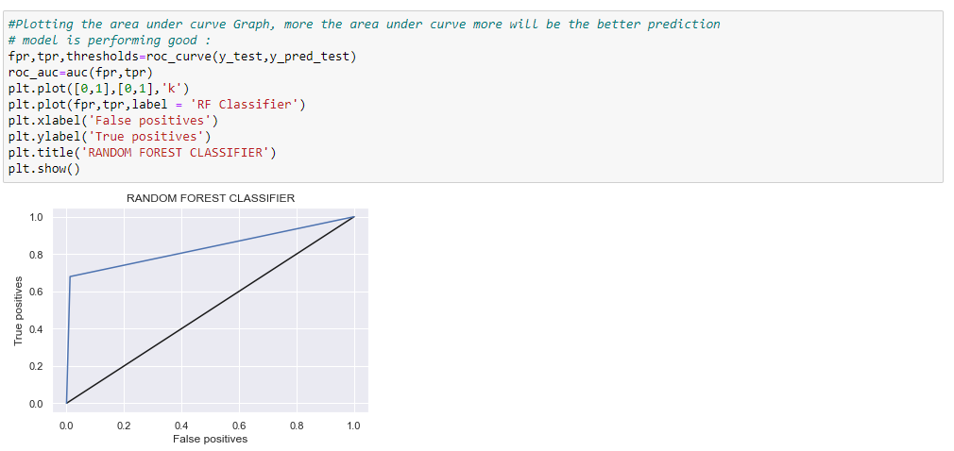

Slide 8
Model building

Slide 9

Explanation
The main algorithms used to process this dataset are:-
Logistic Regression,
Decision Tree Classifier,
Random Forest Classifier,
Ada Boost Classifier and
K-Neighbours Classifier
Among the above algorithms Random Forest Classifier model is showing the best accuracy where :

